Slide 1
TCR-Epitope Binding Affinity Prediction
Topic：bioinformatics & Machine Learning
CS5483, Semester B 2024
Group 6
YANG Yongze 58162280
ZOU Jiaxi 58481506
DUAN Suyang 58490066
FANG Mingyuan 58132226

Slide 2

1
Introduction
Content
Pre-processing &
Feature Engineering
2
3
Training & Evaluation
4
Model Ensembling
5
Conclusion

Slide 3
01
Introduction
Problem Description
Dataset Intro

Slide 4
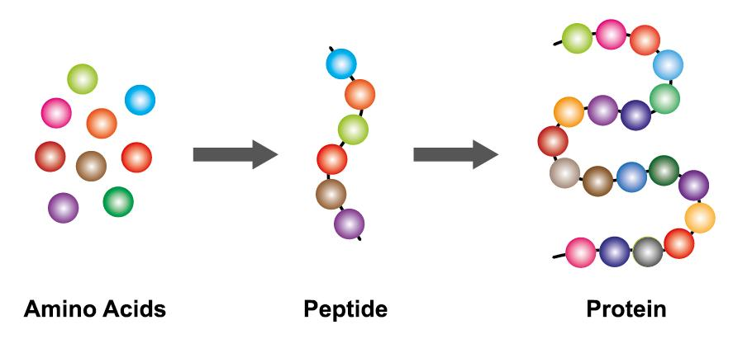
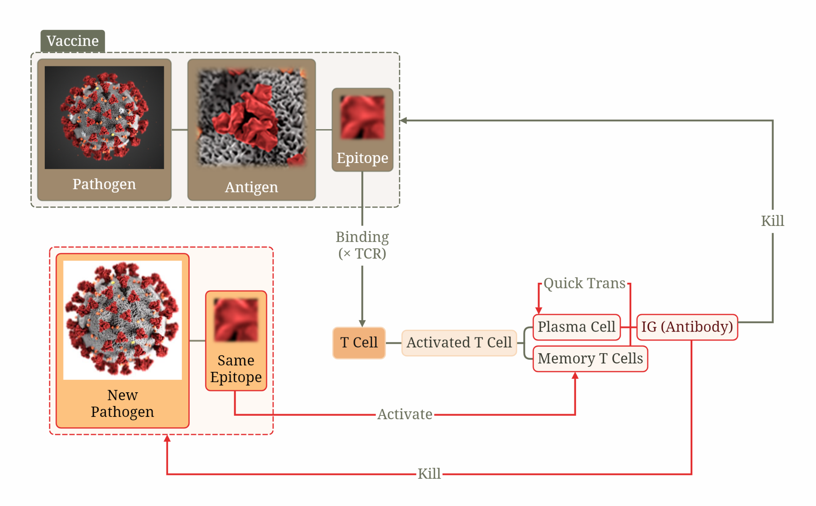
Problem Description
“TCR”
“Epitope”
“Binding”

Slide 5
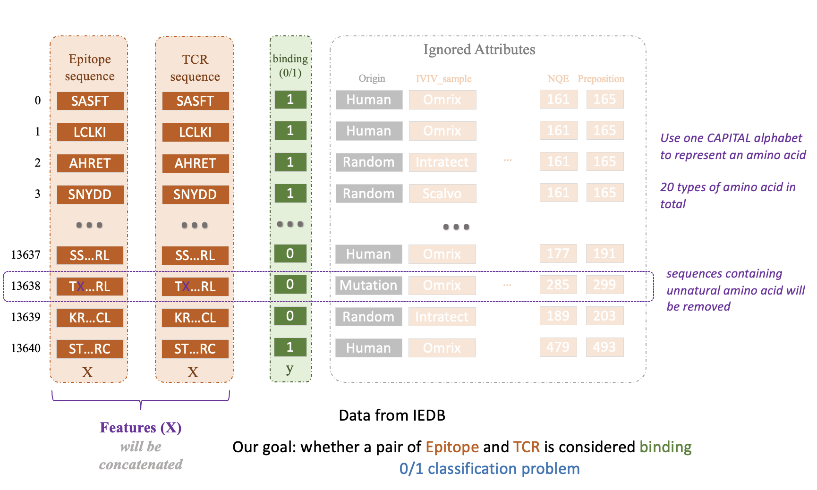
Dataset Intro
binding TCR-epitope pairs collected from publicly available databases: VDJdb, McPAS-TCR, and IEDB

Slide 6
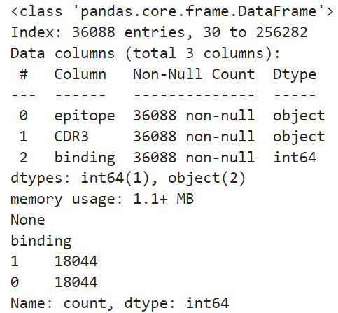
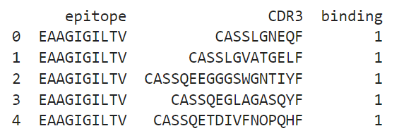
Dataset Intro
Selected 3 most numerous epitopes
(whole dataset way too large)
binding TCR-epitope pairs collected from publicly available databases: VDJdb, McPAS-TCR, and IEDB

Slide 7
Preprocessing &
Feature Engineering
02
Amino Acid Encoding
Normalisation and Feature Concatenation

Slide 8
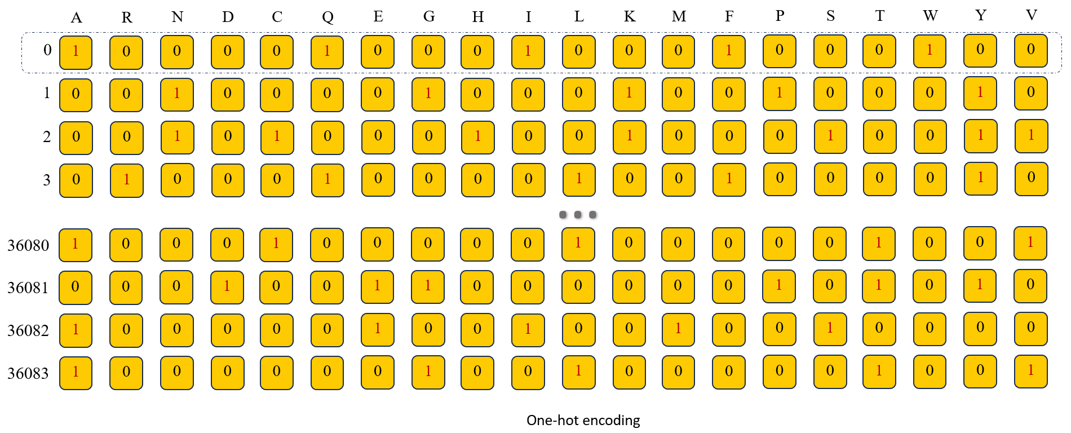
Amino Acid Encoding: One-Hot Encoding

Slide 9
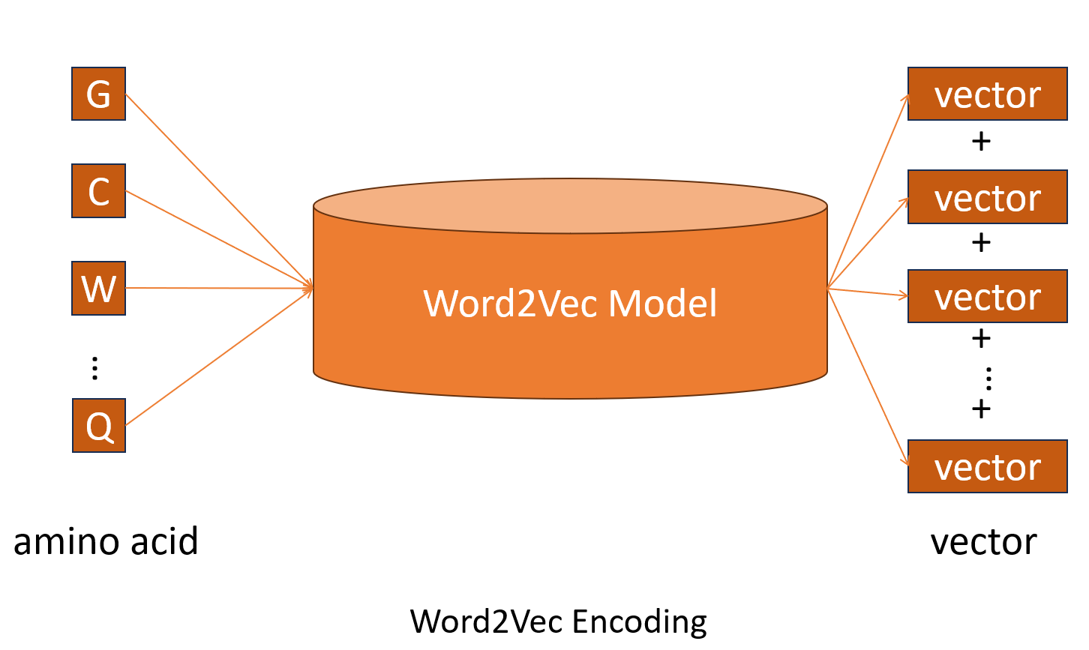
Amino Acid Encoding: Word2Vec[1]
Treat each amino acid as a word
[1] Le, Quoc, and Tomas Mikolov. "Distributed representations of sentences and documents." International conference on machine learning. PMLR, 2014.

Slide 10
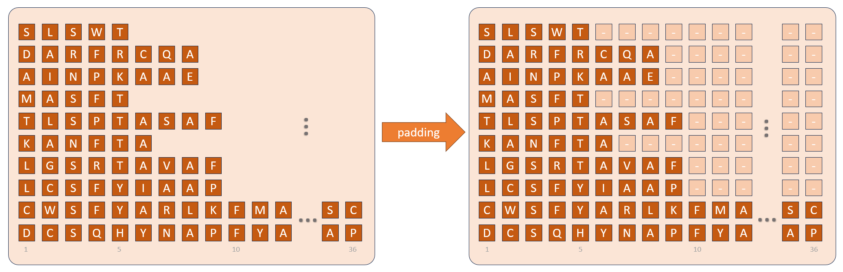
Amino Acid Encoding: Atchley Factor Mapping [2]
CDR3 Various Length?
[2] Atchley, William R., et al. "Solving the protein sequence metric problem." Proceedings of the National Academy of Sciences 102.18 (2005): 6395-6400.

Slide 11
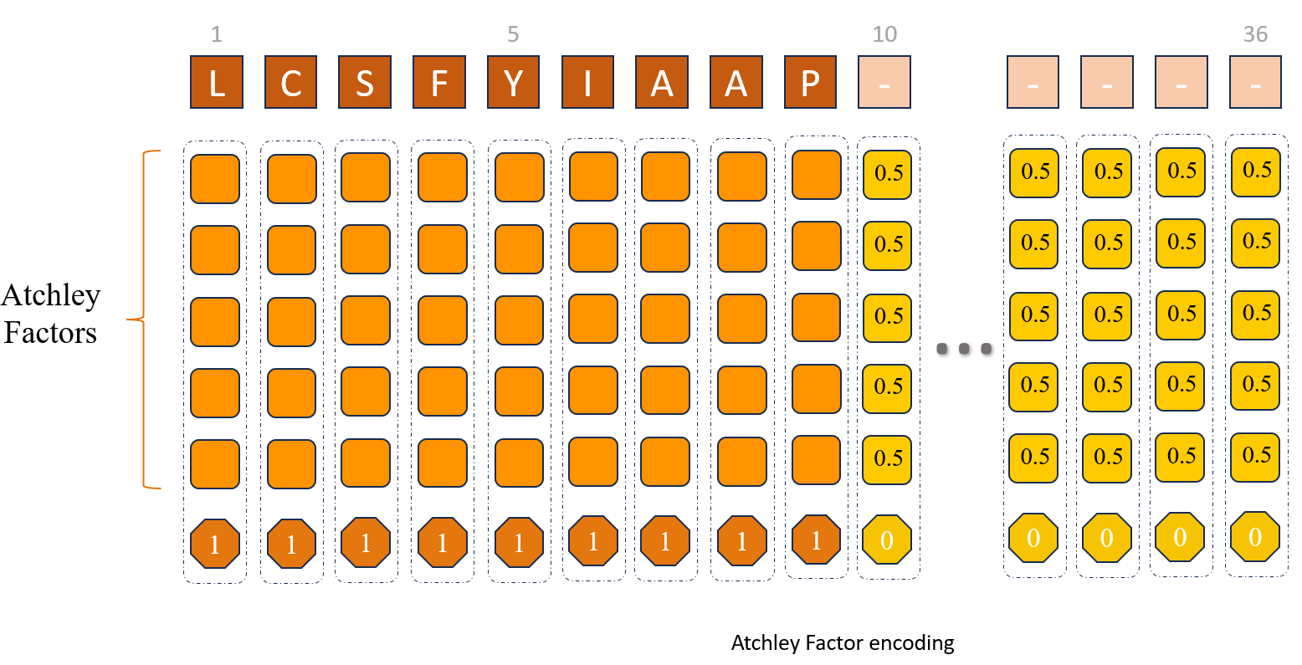
Amino Acid Encoding: Atchley Factor Mapping [2]
- In 2005, Atchley et al.[2] proposed a method to encode amino acids, using five physicochemical properties.
- We used padding methods from Luu et al [3]
1) default values = 0.5 ;
2) a labeling dimension:
- an amino acid (1) or
- a pad (0).
[2] Atchley, William R., et al. "Solving the protein sequence metric problem." Proceedings of the National Academy of Sciences 102.18 (2005): 6395-6400.
[3] Luu, Alan M et al. “Predicting TCR-Epitope Binding Specificity Using Deep Metric Learning and Multimodal Learning.” Genes vol. 12,4 572. 15 Apr. 2021, doi:10.3390/genes12040572

Slide 12
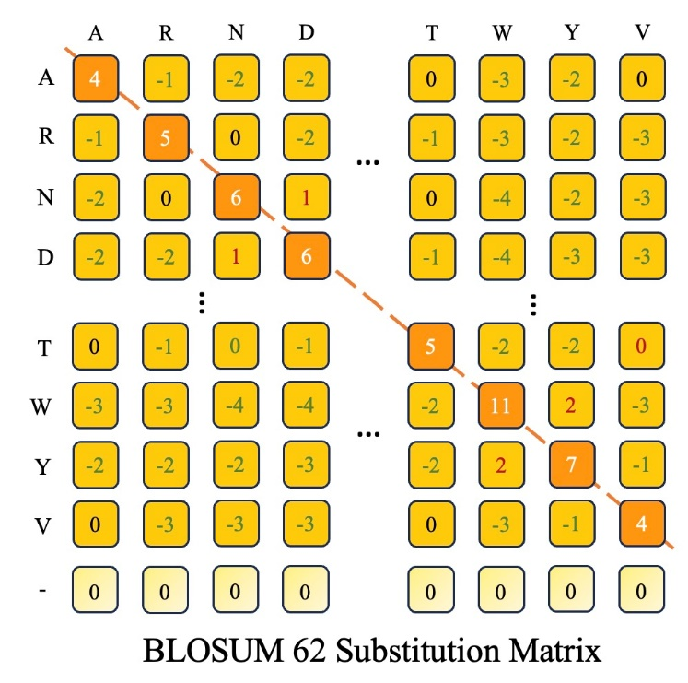
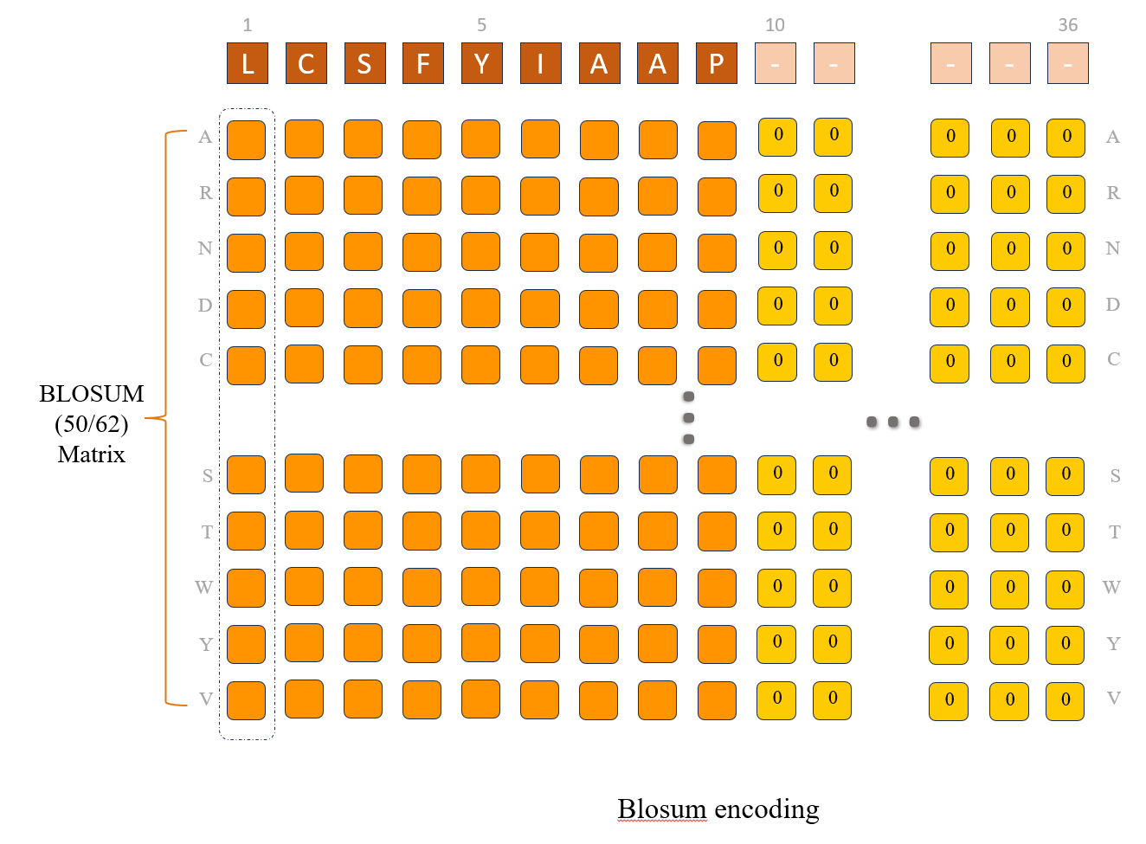
BLOcks SUBstitution (BLOSUM) Matrix [4]
Similarity between Amino Acid
physicochemical properties
[4] Henikoff, Steven, and Jorja G. Henikoff. "Amino acid substitution matrices from protein blocks." Proceedings of the National Academy of Sciences 89.22 (1992): 10915-10919.

Slide 13
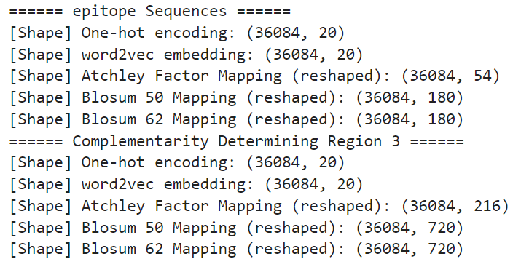
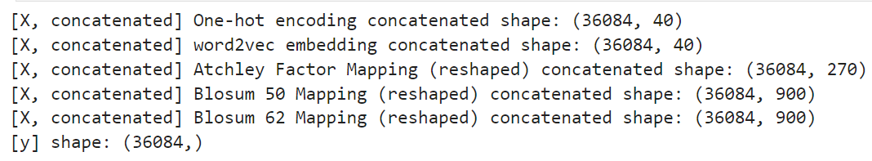
Further Pre-Processing
Min-Max Normalise
&
Feature Concatenation
(tcr and epitope)

Slide 14
03
Training & Evaluation
Hyper Parameter
Training & Evaluation

Slide 15
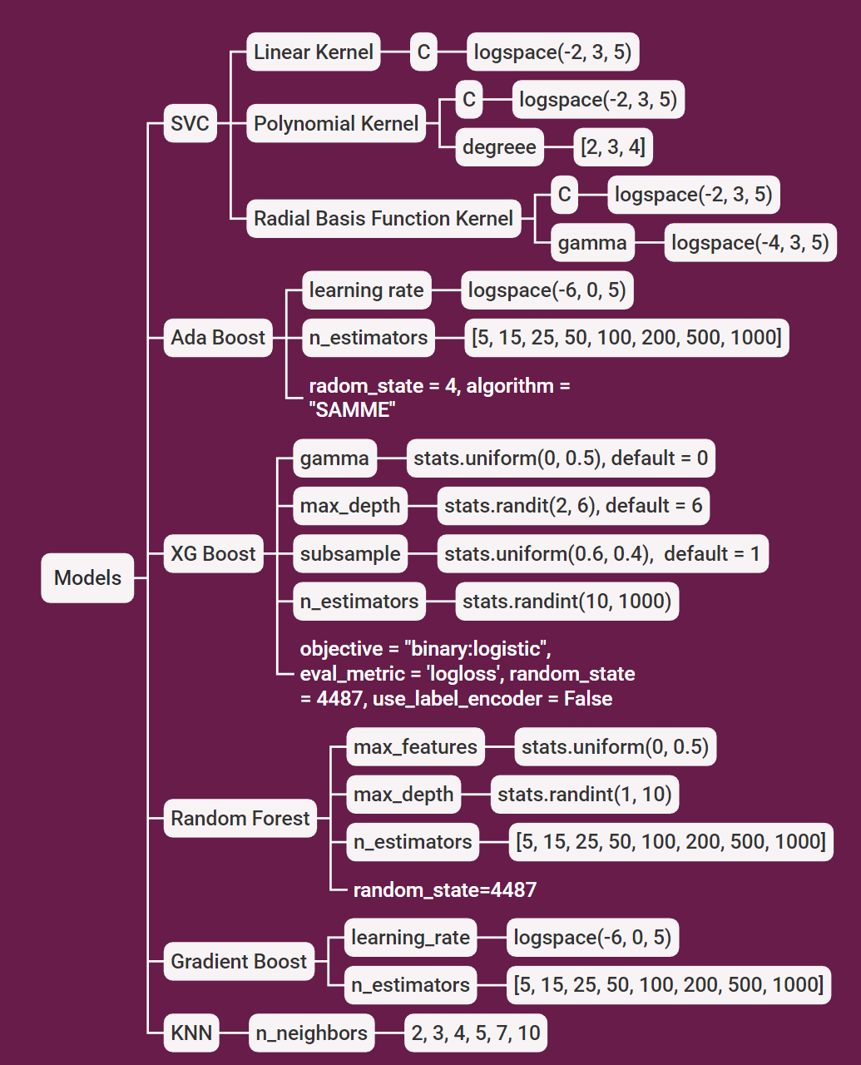
Hyper Parameters
Grid Search for the best hyper parameter set
AUC as creteria
Search space shown in diagram:

Slide 16
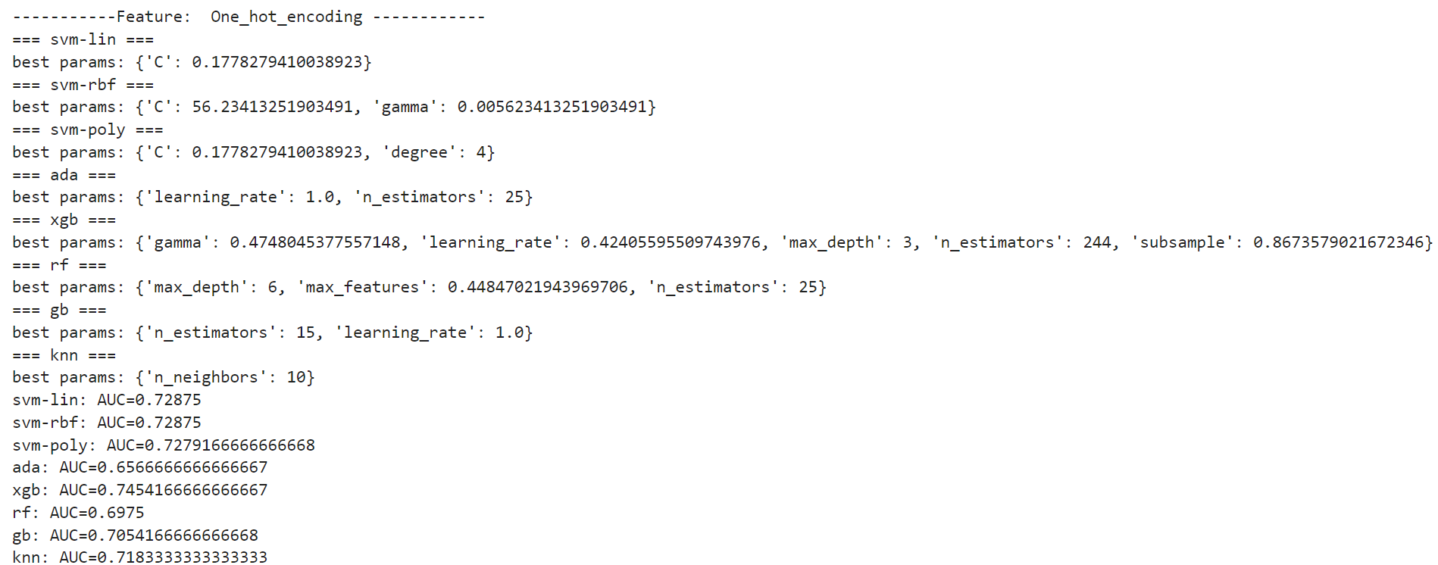
Hyper Parameters
Grid Search for the best hyper parameter set AUC as creteria
e.g. One-Hot Encoding set
See our report for all results

Slide 17
04
Model Ensembling
Soft Voting

Slide 18
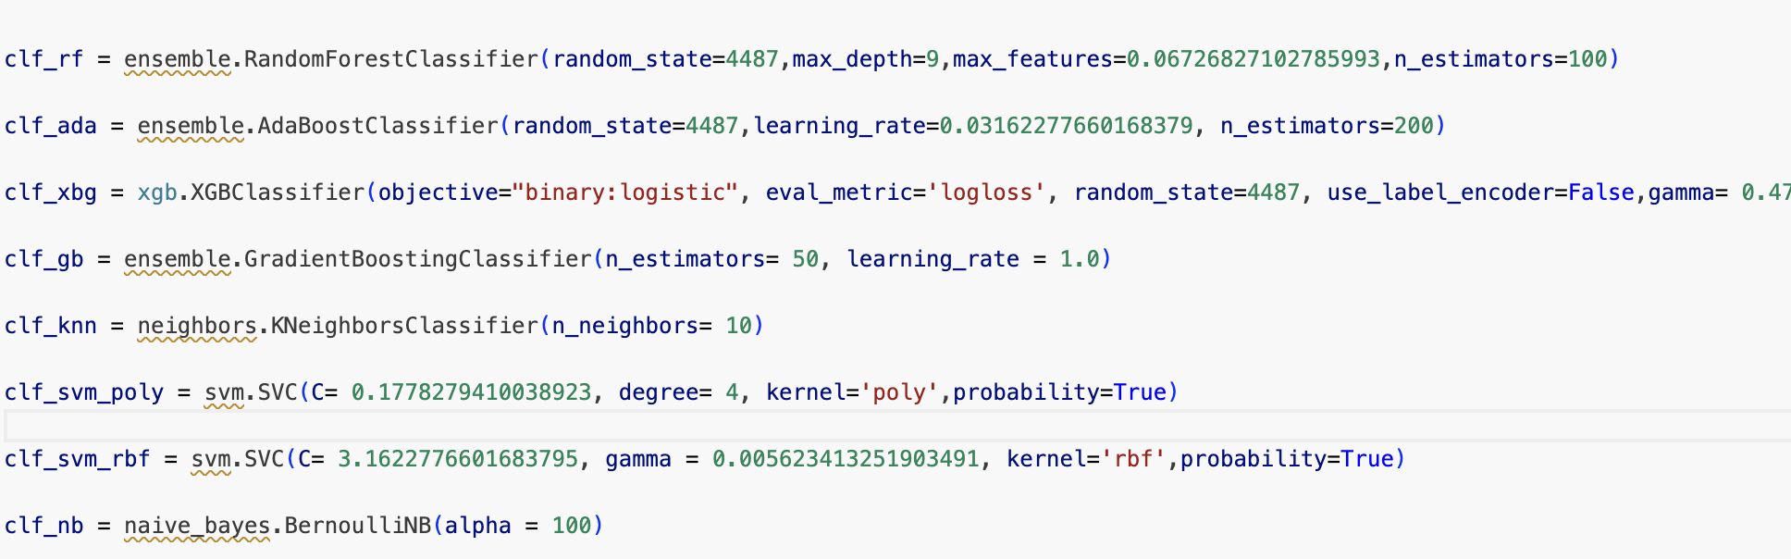
Soft Voting
Classifier List: Classifiers with best parameters
Build voting classifier (soft voting):
voting_clf = ensemble.VotingClassifier(estimators=clf_list, voting='soft')

Slide 19
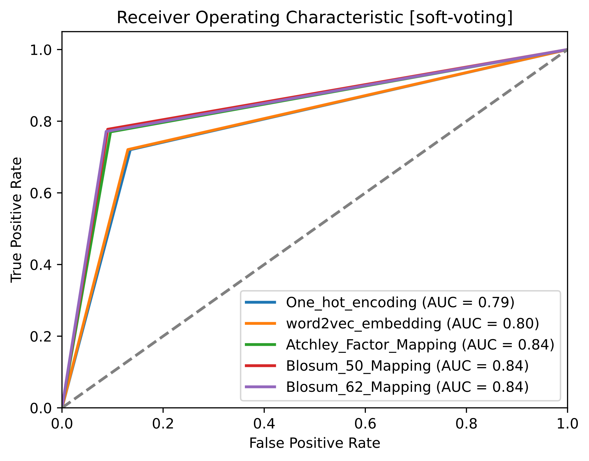
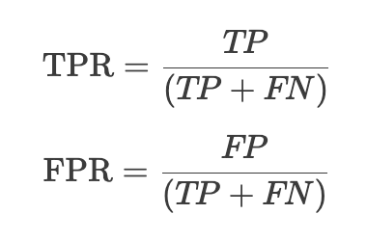
EVALUATION : AUROC
AUROC is a metric often used to evaluate TCR-Epitope binding.

Slide 20
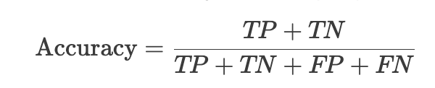
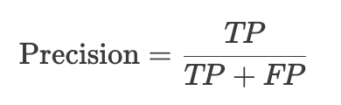
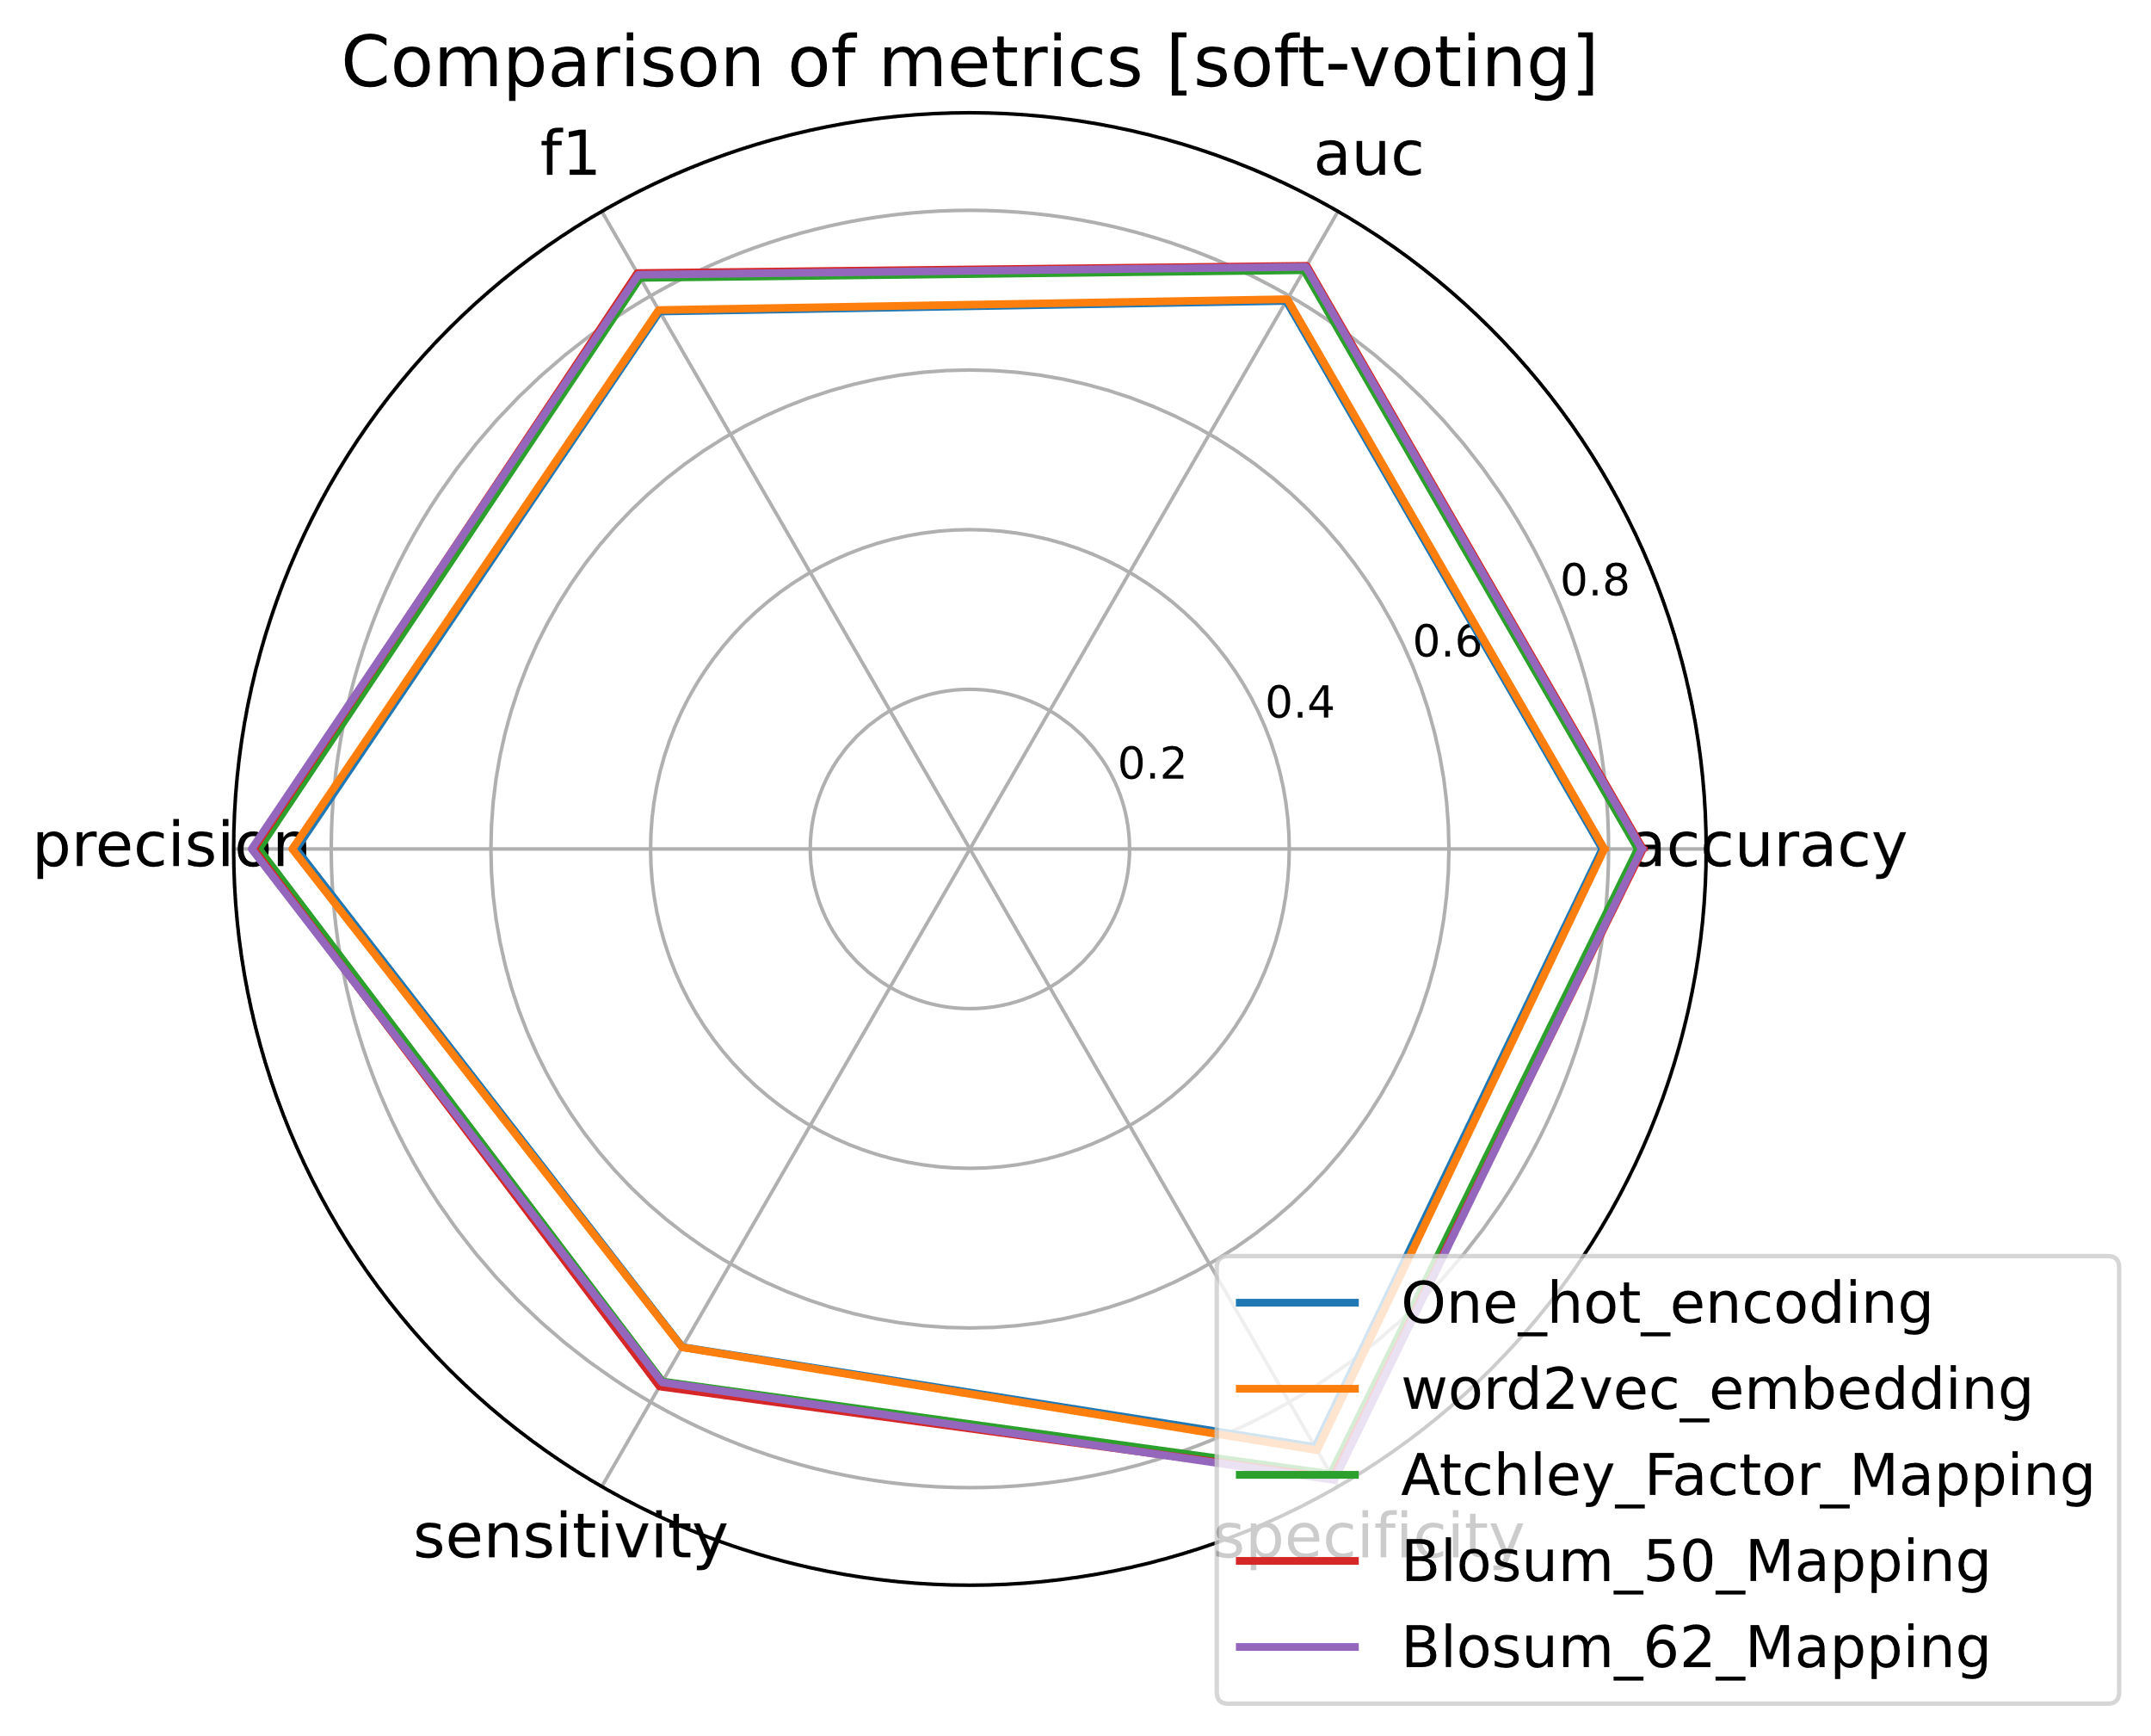
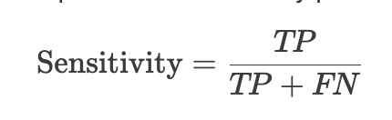
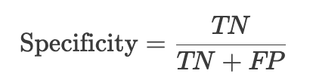
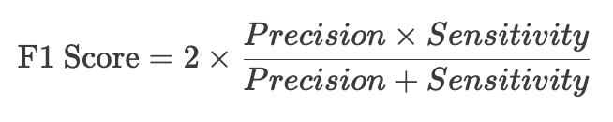
EVALUATION: Other metrics
Other metrics for 0/1 classification:
Where:

Slide 21
Evaluation
Atchley Factor Mapping
Blosum 50 / 62
>
One-Hot Encoding
Word2Vec

Slide 22
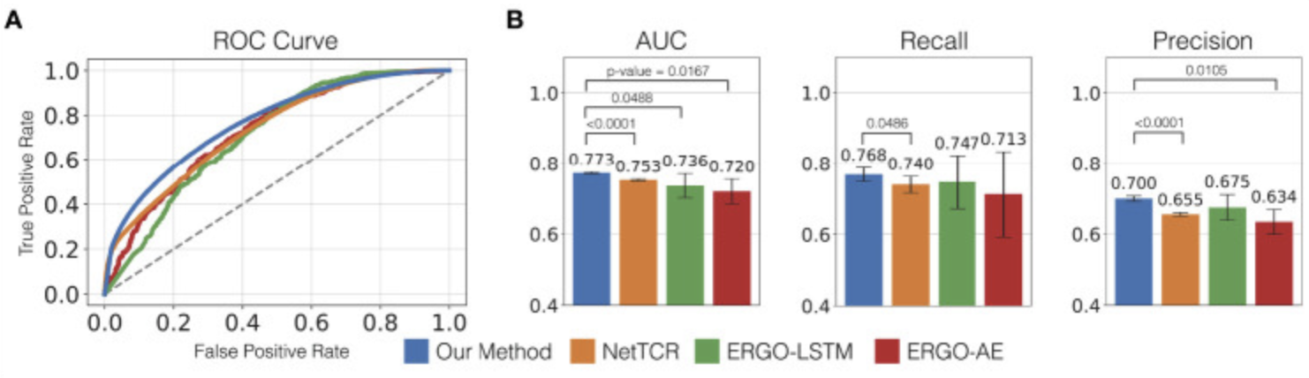
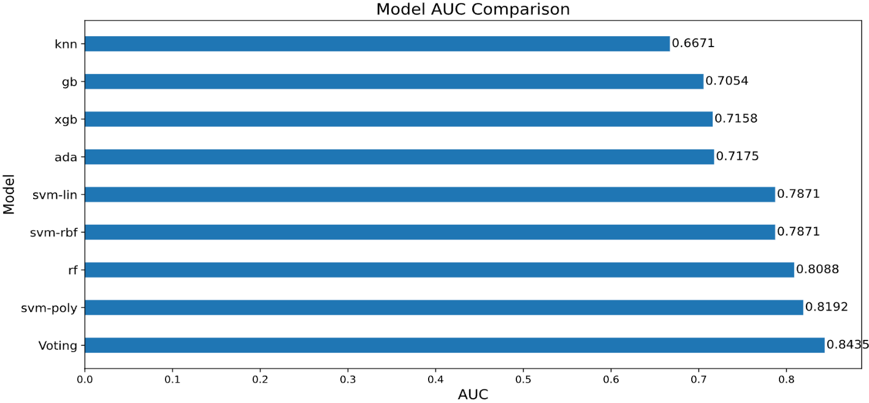
Evaluation
Previous
Work:
ATM-TCR[5]
Our work:
[5] Cai, Michael, et al. "ATM-TCR: TCR-epitope binding affinity prediction using a multi-head self-attention model." Frontiers in immunology 13 (2022): 893247.

Slide 23
05
Conclusion
Whole Pipeline & Summary

Slide 24
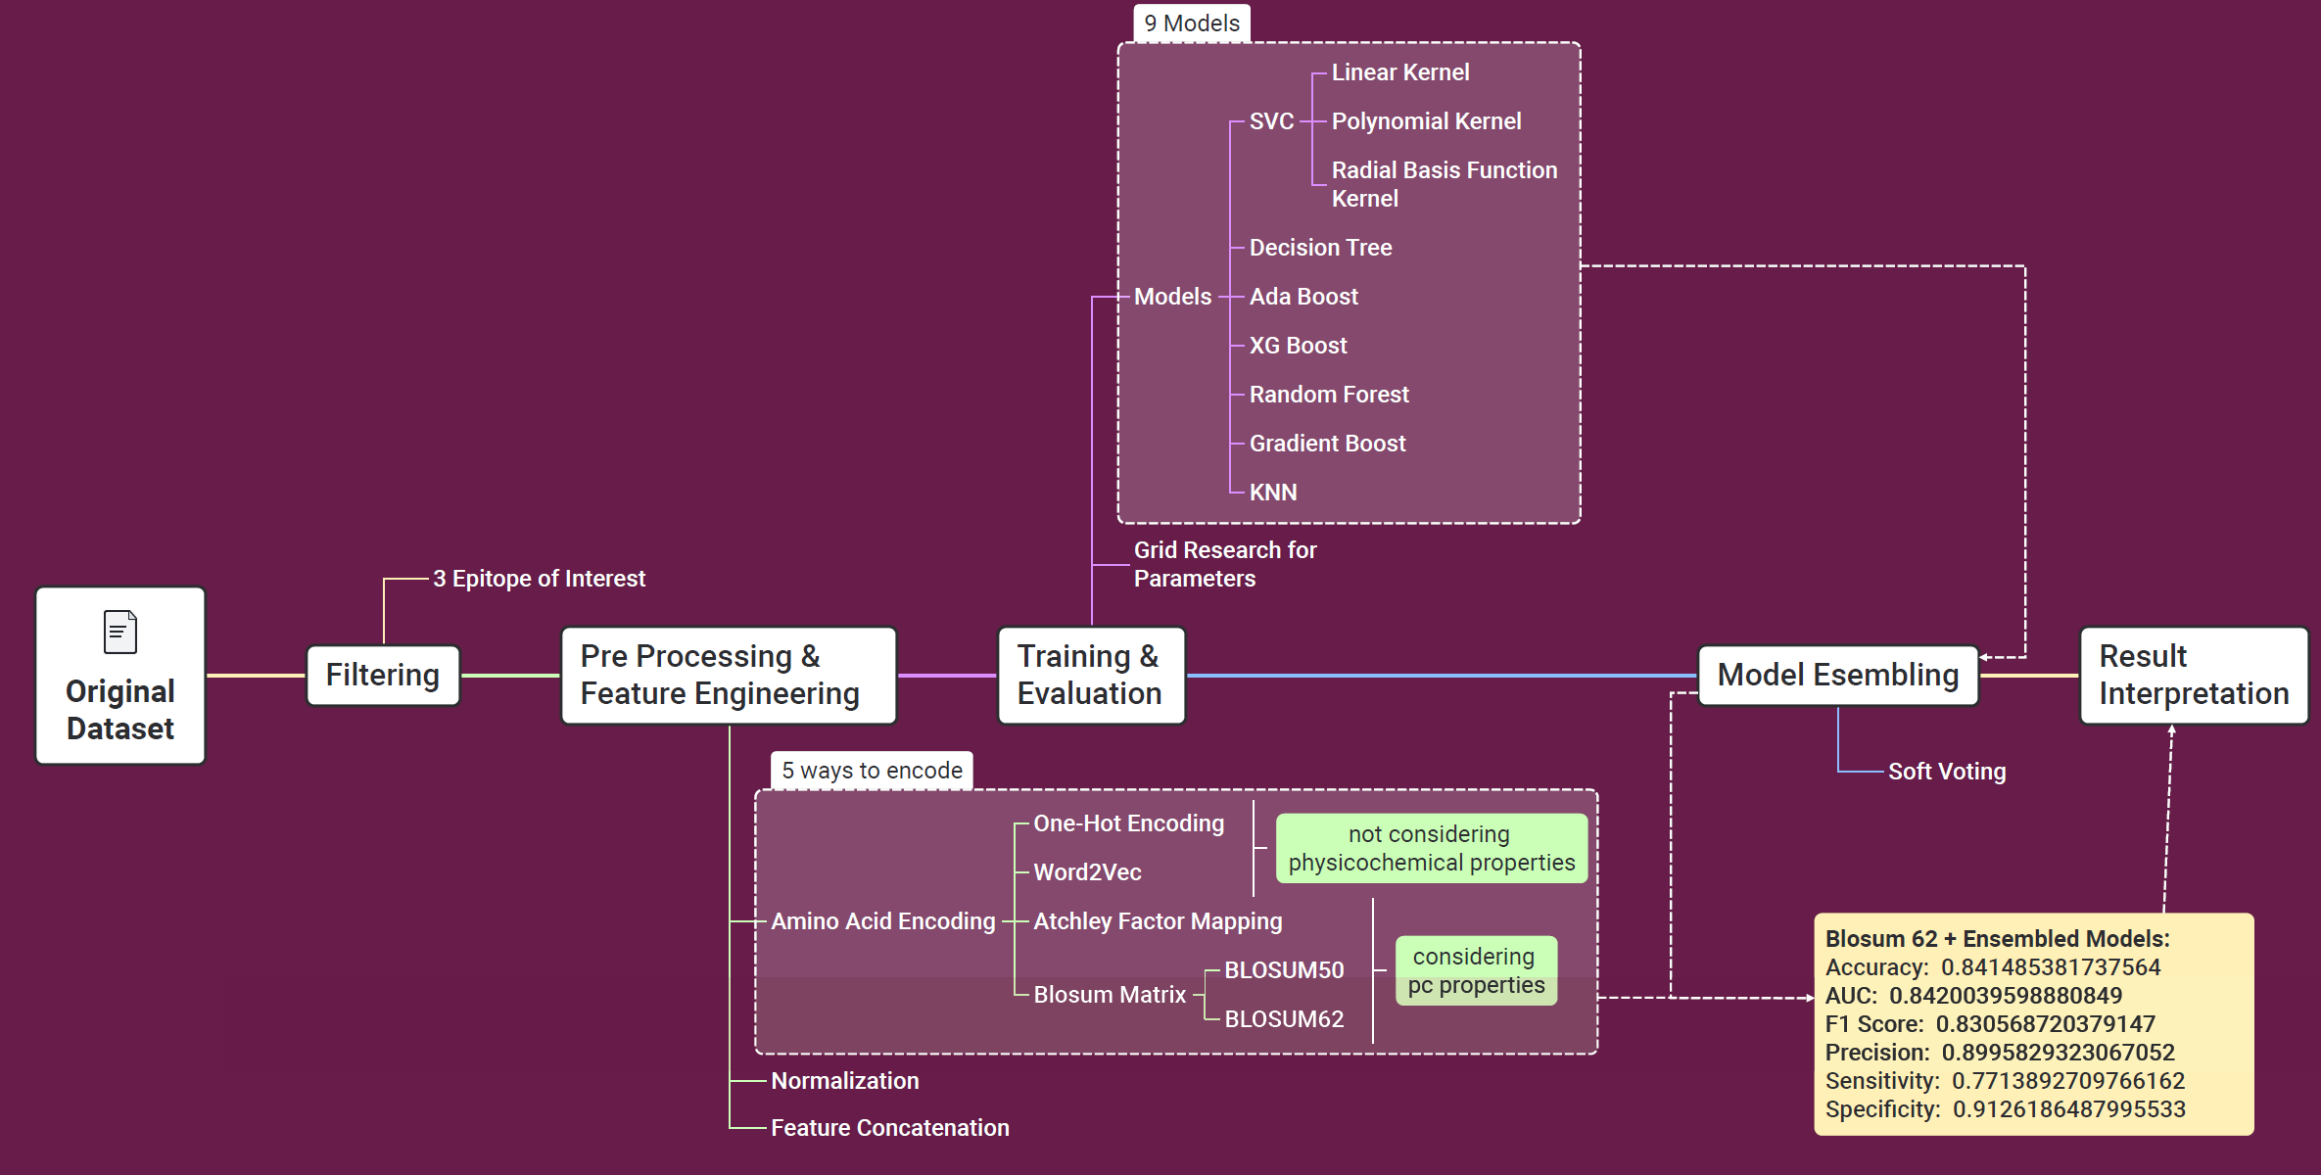
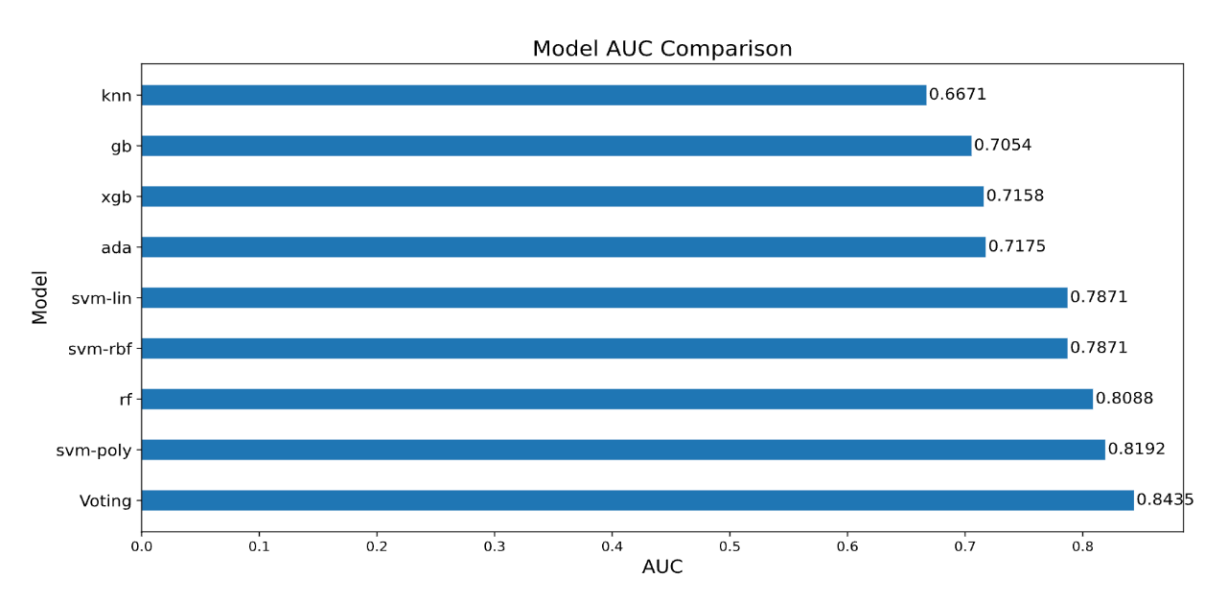
Project Summary

Slide 25
Contribution
- Compared 5 different encode methods for feature representation;
- Compared 9 machine learning methods with best parameters, and add a voting classifier;
- 5*（9+1） = 50 comparisons in total!
- our AUROC is better than some published papers;

Slide 26
References
[1] Le, Quoc, and Tomas Mikolov. "Distributed representations of sentences and documents." International conference on machine learning. PMLR, 2014.
[2] Atchley, William R., et al. "Solving the protein sequence metric problem." Proceedings of the National Academy of Sciences 102.18 (2005): 6395-6400.
[3] Luu, Alan M et al. “Predicting TCR-Epitope Binding Specificity Using Deep Metric Learning and Multimodal Learning.” Genes vol. 12,4 572. 15 Apr. 2021, doi:10.3390/genes12040572
[4] Henikoff, Steven, and Jorja G. Henikoff. "Amino acid substitution matrices from protein blocks." Proceedings of the National Academy of Sciences 89.22 (1992): 10915-10919.
[5] Cai, Michael, et al. "ATM-TCR: TCR-epitope binding affinity prediction using a multi-head self-attention model." Frontiers in immunology 13 (2022): 893247.

Slide 27

Thanks！

